Slide 1
Truck Platooning
Ghazaleh Hadian
Behnoosh Hashemi
Roghieh Farajialamooti
Danial Rafiee
Ali Beiti

Slide 2
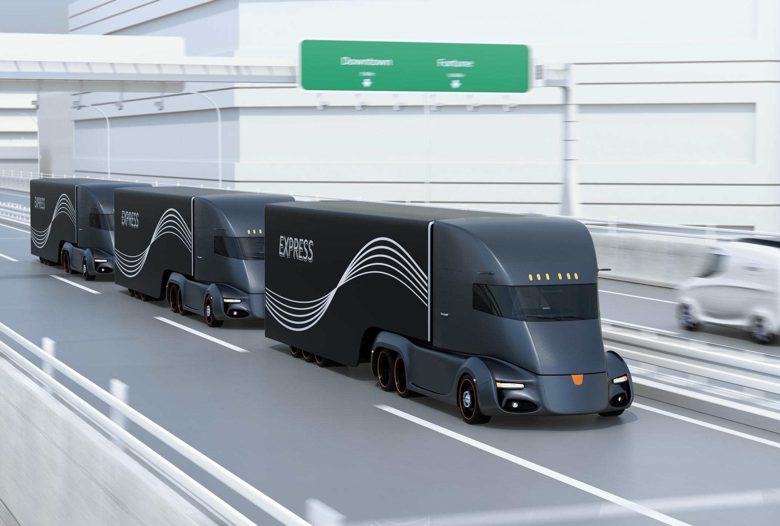
Outline
Introduction
System Architecture
Communication Topology
Structural Diagrams
Behavioral Diagrams
Failure Management
Implementation
Summery

Slide 3
Introduction
Benefit
Motivation
Nature
Truck Transportation
Platooning Formation
Reduction in fuel consuming
Reduce CO2 emissions
Increase Road Safety
Decrease Driver workloads
Fuel-efficiency-based research
Technique-related research

Slide 4
System Architecture

Slide 5
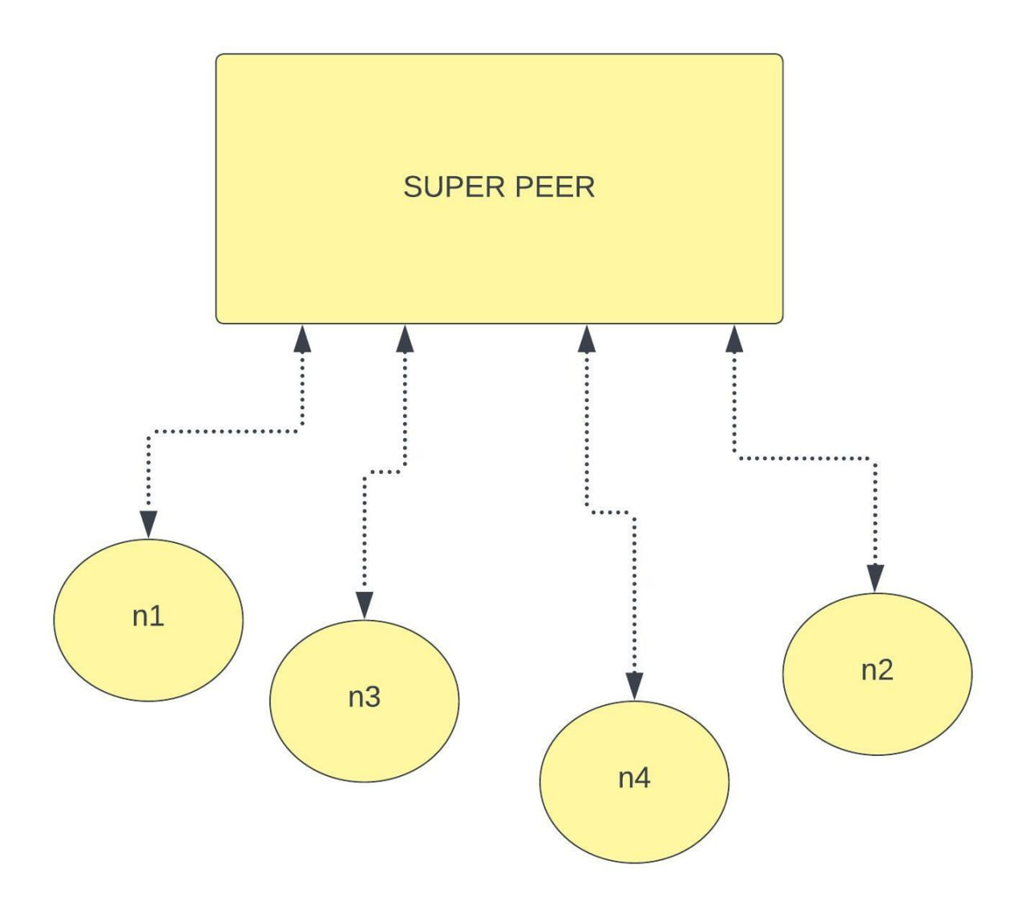
Semi-centralized
Peer to Peer (P2P)

Slide 6
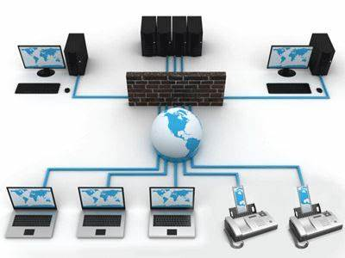
Independent computing units capability of nodes to change role
Robust against individual node failure

Slide 7
Communication Protocol

Slide 8
UDP
Connectionless
Low latency
Fast
Suitable for hard-real time system

Slide 9
Sketch of Approach

Slide 10
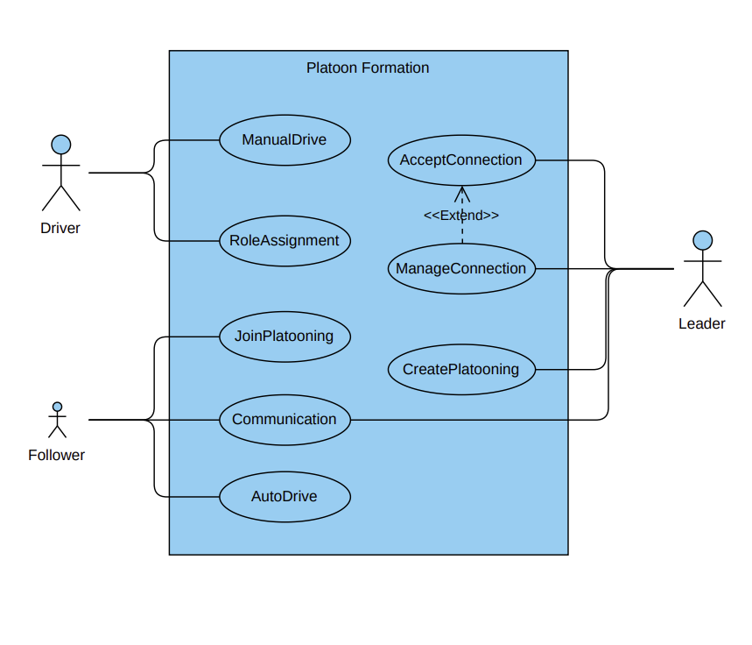
Use Case-Platoon Formation

Slide 11
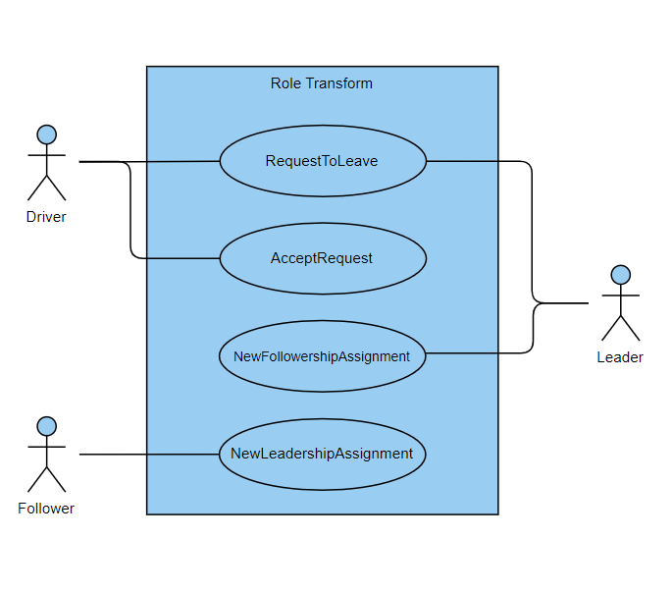
Use Case-Role Transformation

Slide 12
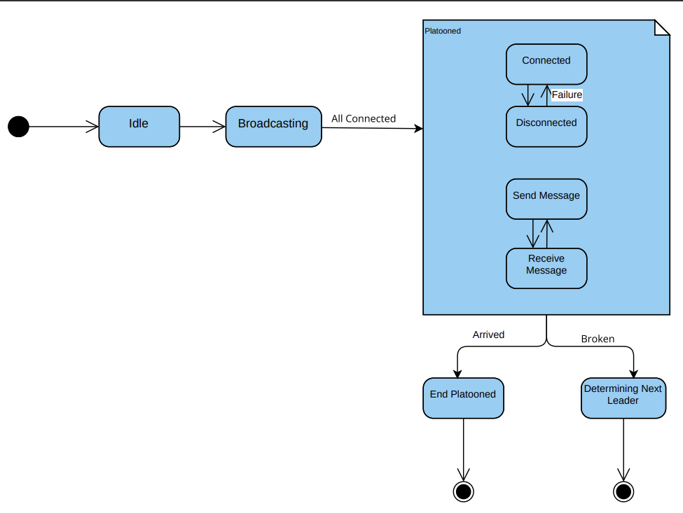
State Machine - Leader

Slide 13
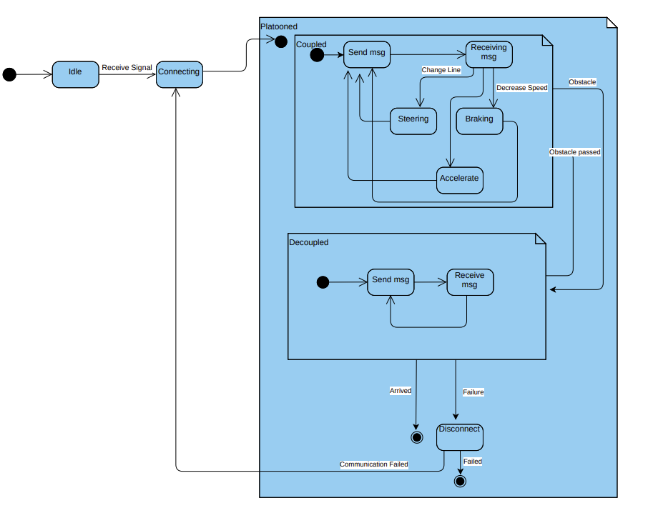
State Machine - Follower

Slide 14
Requirements Diagram

Slide 15
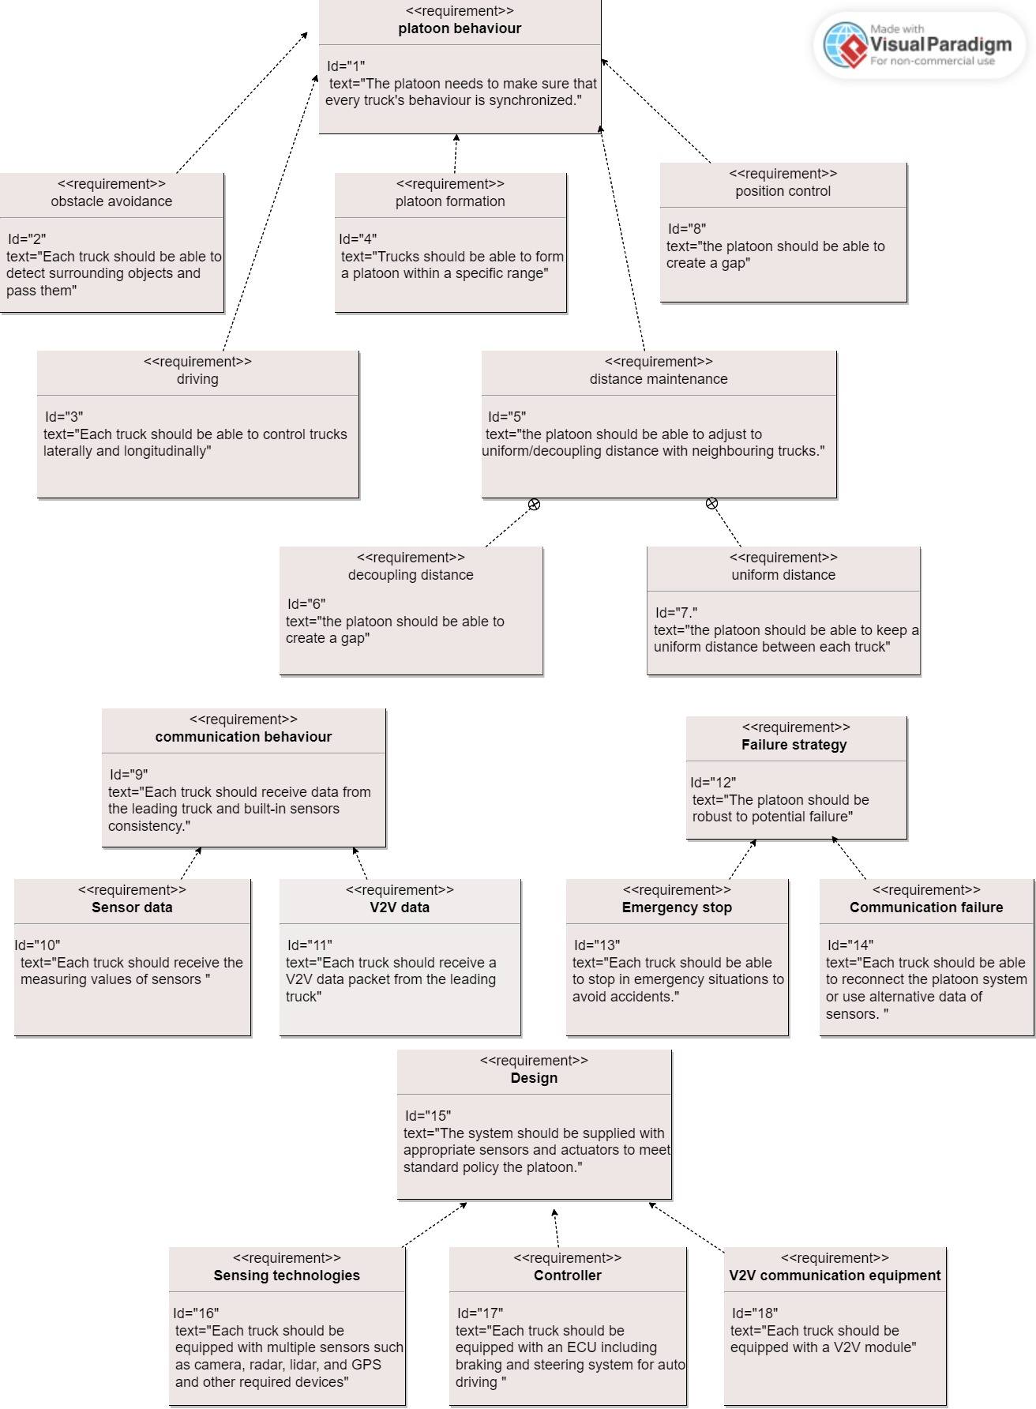
Platoon behavior:
Platoon formation
Distance maintenance
Uniform distance
Decoupling distance
Position control
Driving
Obstacle avoidance
Communication behavior:
Sensor data
V2V data
Design Requirements:
Design
Failure strategy
Failure strategy:
Emergency stop
Communication failure

Slide 16
Failure Management

Slide 17
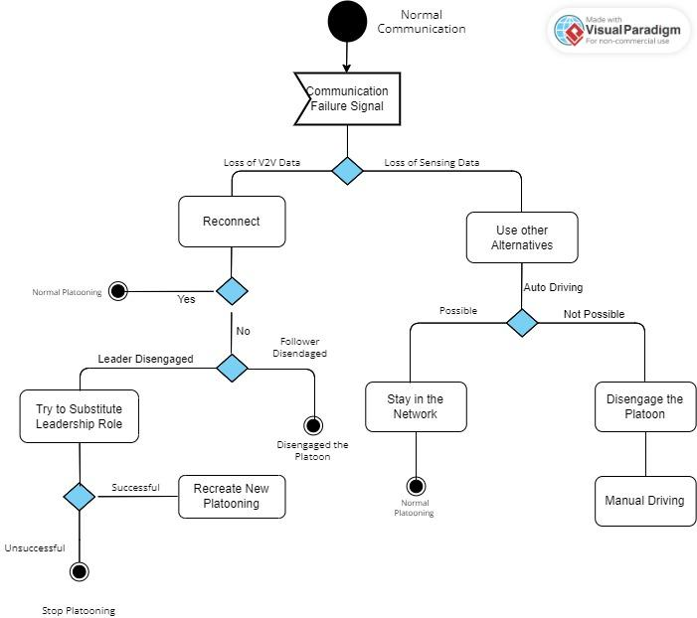
V2V Communication Failure
Sensing Data Failure

Slide 18
Concurrency vs Parallelization

Slide 19
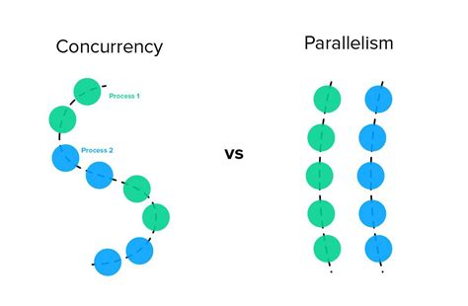
Parallelism:
is about multiple tasks or subtasks of the same task that literally run at the same time on a hardware with multiple computing resources like multi-core processor so that the task can be finished faster.
Concurrency:
is about multiple tasks which start, run, and complete in overlapping time periods, in no specific order.

Slide 20
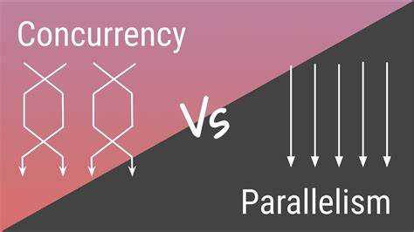
In Truck Platooning, the following tasks are implemented by using “OpenMP” and “pthread”, to apply concurrency and parallelism.
Functions for autonomous driving mode of each following truck
Communication messages

Slide 21
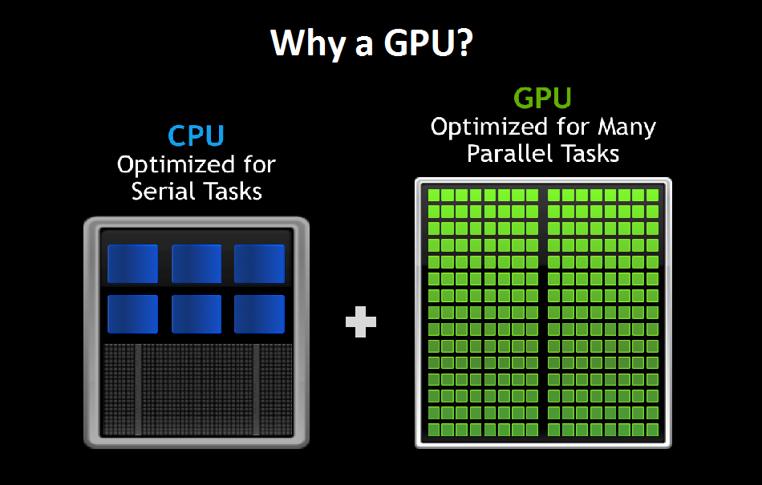
GPU Programming:
A GPU has a massively parallel architecture consisting of thousands of smaller, more efficient cores designed for handling multiple tasks simultaneously to reduce response time.
In our system, reading the sensor values and storing them in the array of readings in each truck concurrently is developed on GPU using CUDA.

Slide 22
Implementation

Slide 23
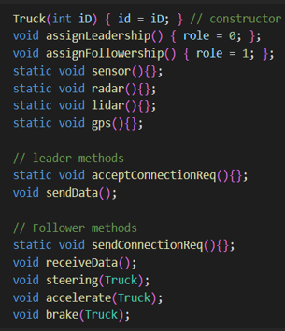
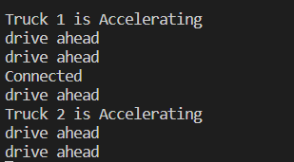
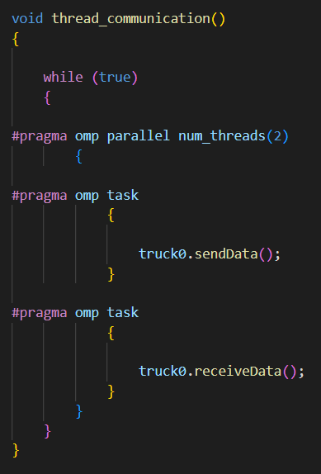
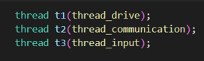
CPU

Slide 24
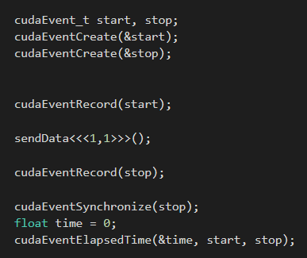
GPU

Slide 25
Summary
Importance of Truck Platooning in the transport sector
Take advantage of parallel and concurrent programming on CPU/GPU for implementation of an adaptive, real-time truck platooning system
Challenges in implementation

